Slide 1
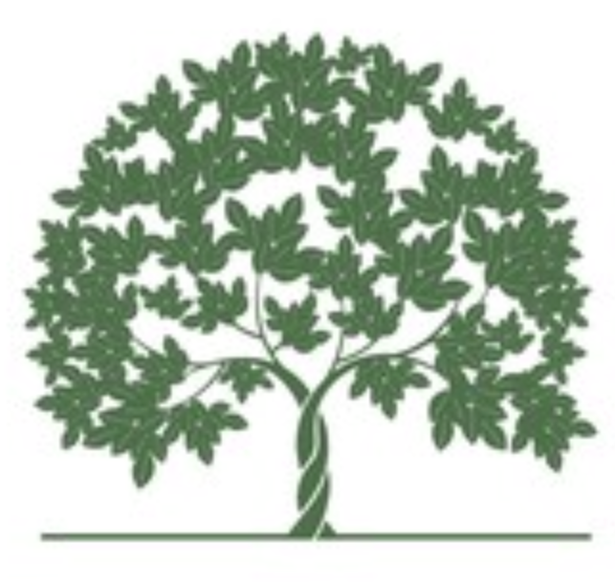

Deforestation and Desertification
March 12th, 2018
By Camille Innocenti
and Alice Riou

Slide 2
Plan
Introduction : Definitions
Deforestation
Facts
Causes
Consequences
Desertification
Facts
Causes
Consequences
Solutions
Conclusion

Slide 3
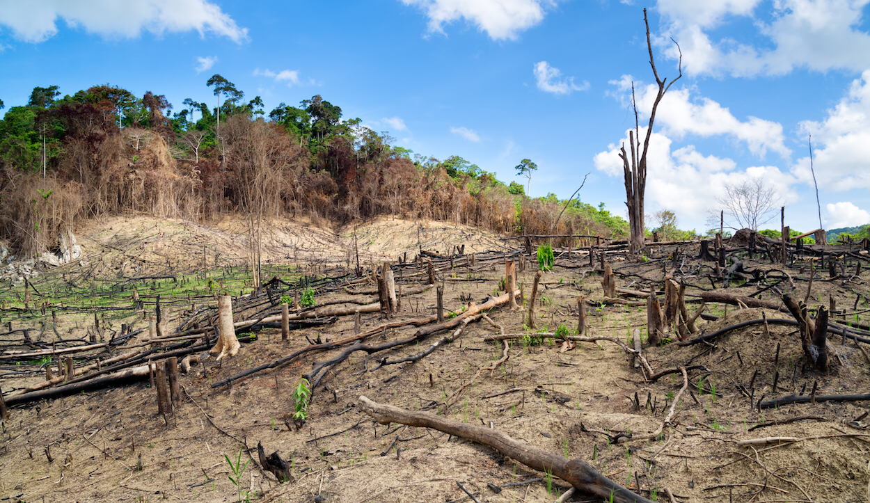
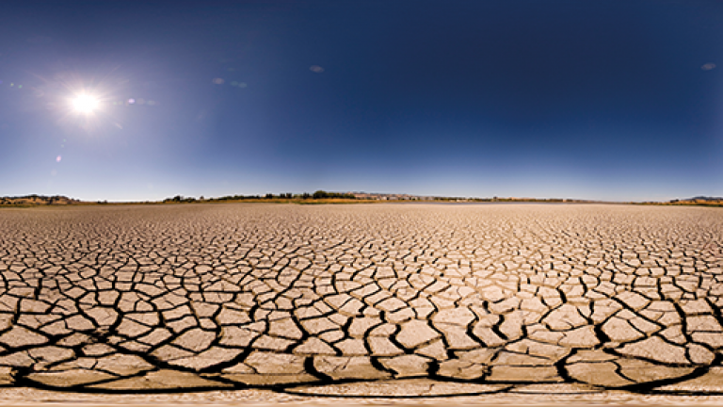
Introduction: Definitions
Deforestation: Decrease and deterioration of forest cover of an area
Desertification: transformation of one fertile land into desert

Slide 4
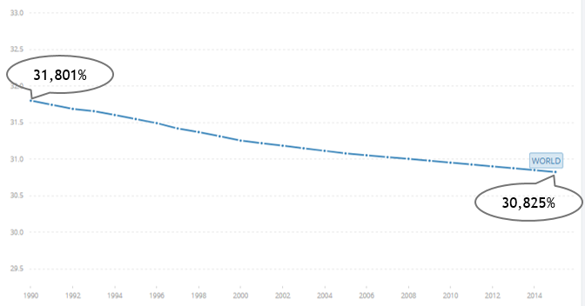
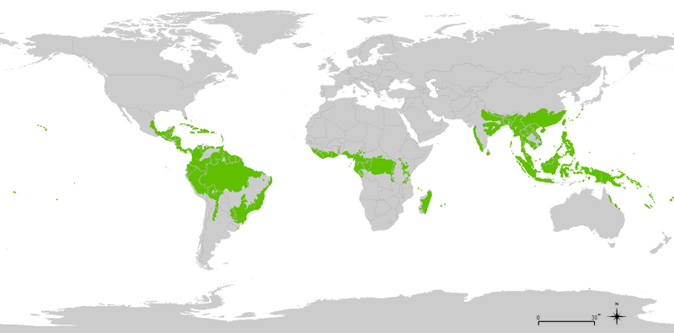
I- Deforestation: Facts
Land area (%)
Tropical rainforests http://speculativeevolution.wikia.com
Time (year)
Every minute, forest the size of 20 football fields is cut down
50% of the world’s tropical forest has been cut down
Tropical forests : → 6-7% of the Earth surface
→ 210 gigatones of carbon
→ Half of plant and animal species

Slide 5
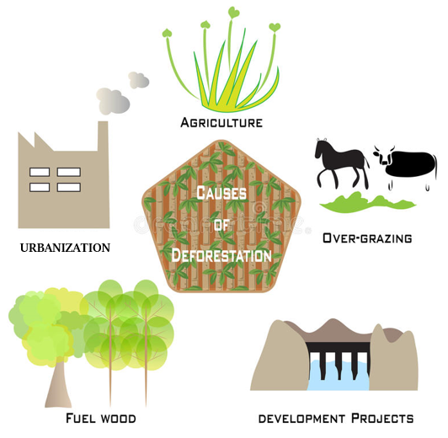
I- Deforestation: Causes
→ Land grabbing
Over population
Infrastructure expansion
Firewood
Fournitures
Industries
https://www.dreamstime.com

Slide 6
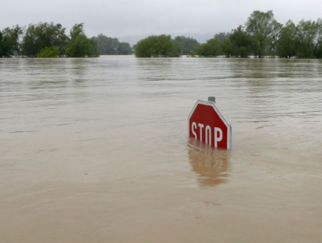
I- Deforestation: consequences
Biodiversity loss
Forest loss → 12 – 17% Greenhouse gas emissions
Increase global warming
Floods / water cycle
Soil erosion and desertification
www.smithsonianmag.com/

Slide 7
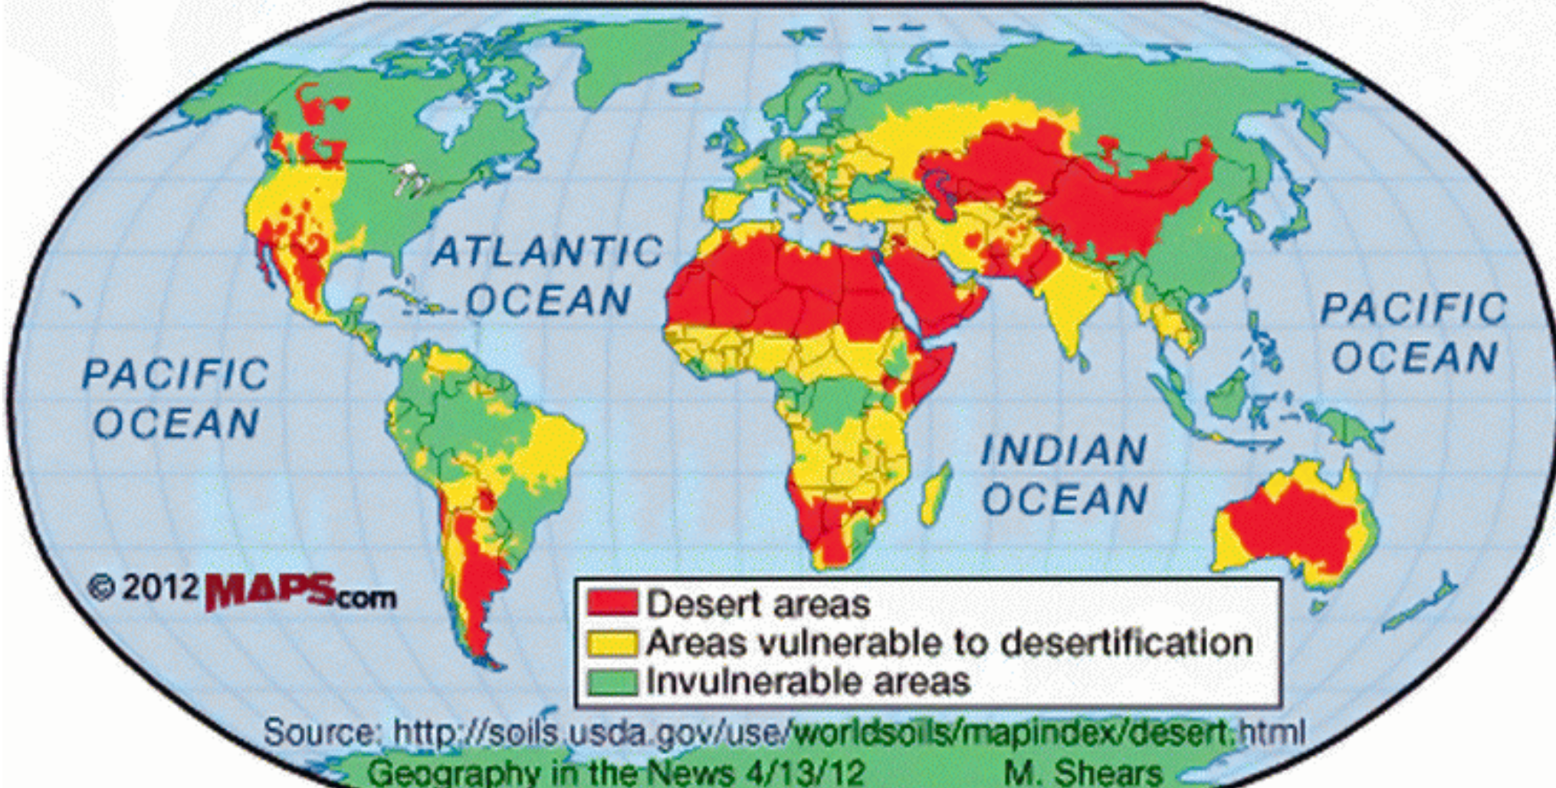
II- Desertification : Facts

Slide 8
Natural disaster
Deforestation
II-Desertification : causes
Overgrazing
Farming practices

Slide 9
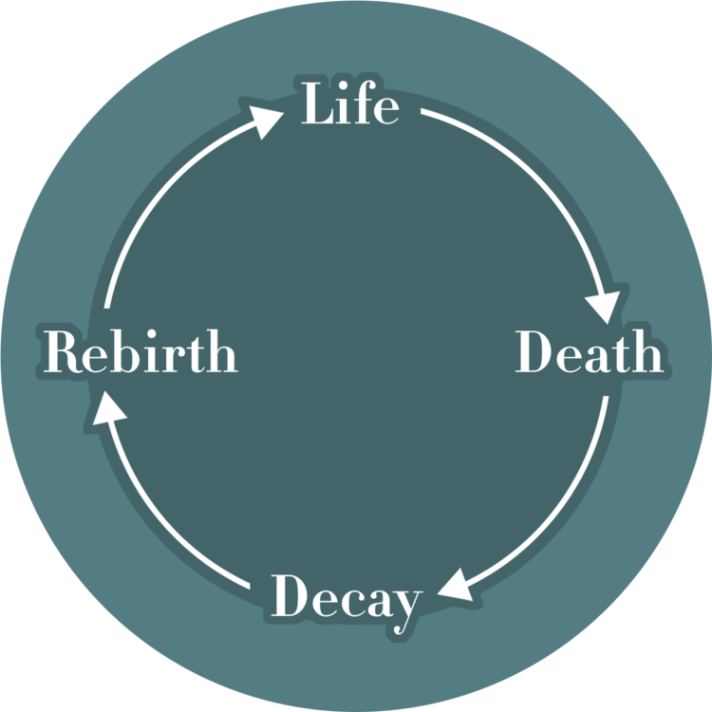
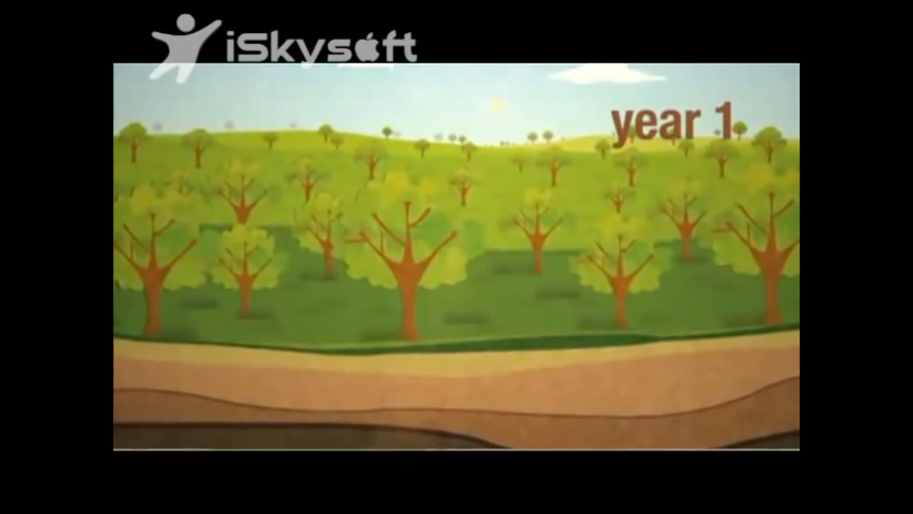
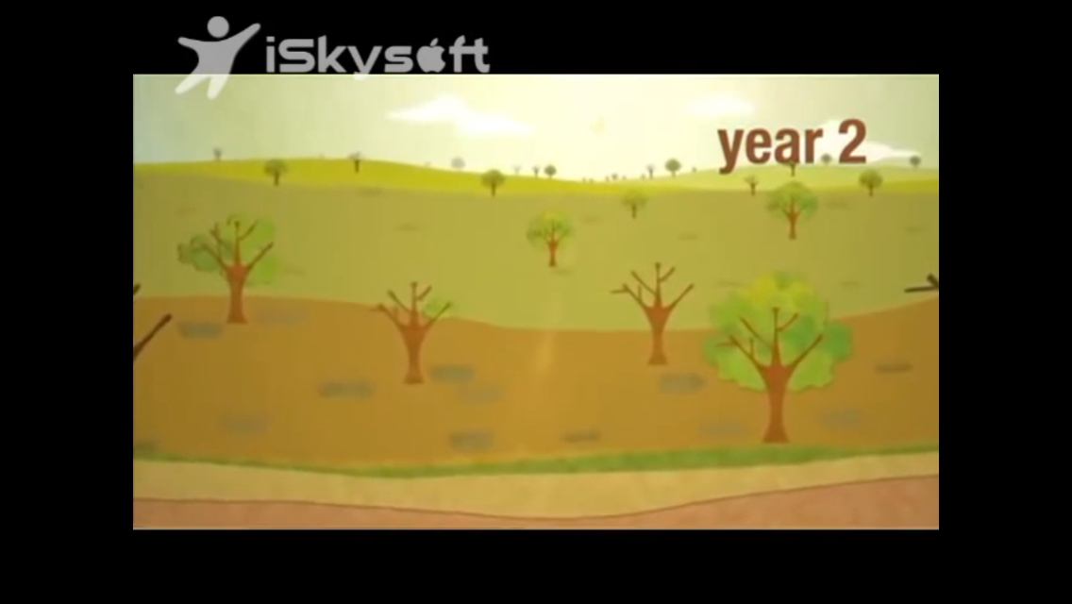
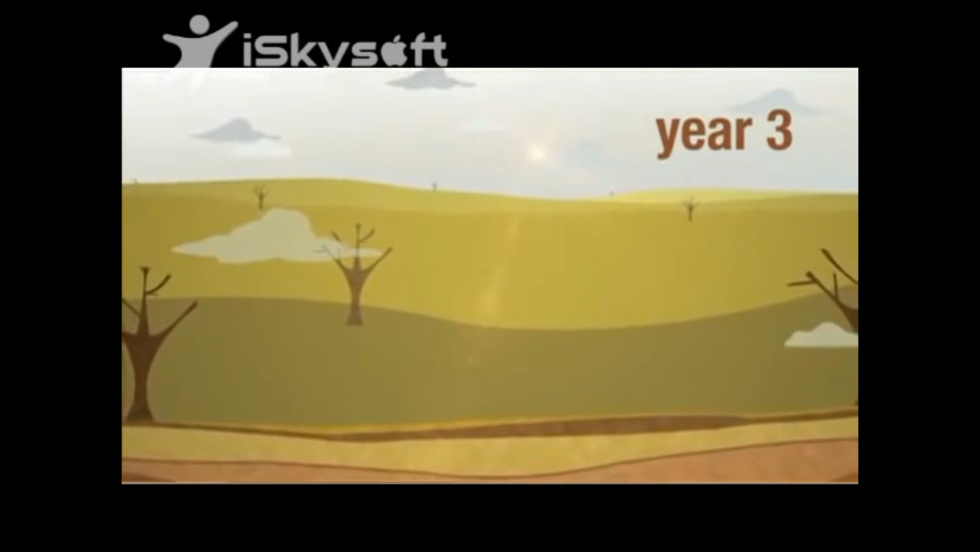
→Erosion
→Drying of soils

Slide 10
II- Desertification: consequences
Hunger
Flooding
Poor water quality

Slide 11
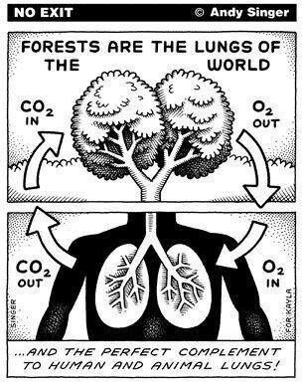
III- Solutions
Change our way to farm
Promoting sustainable choices
Changing the politic
To plant trees
Warn people

Slide 12

Conclusion

Slide 13
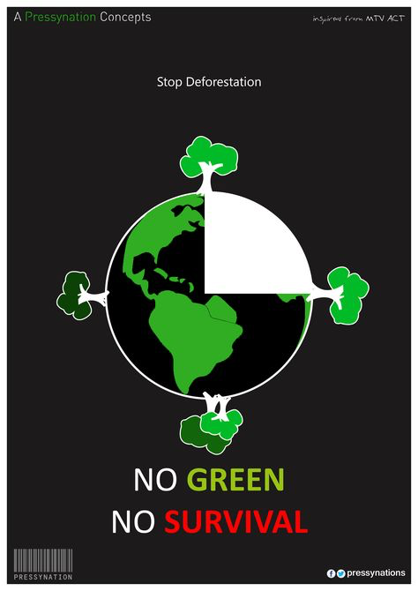
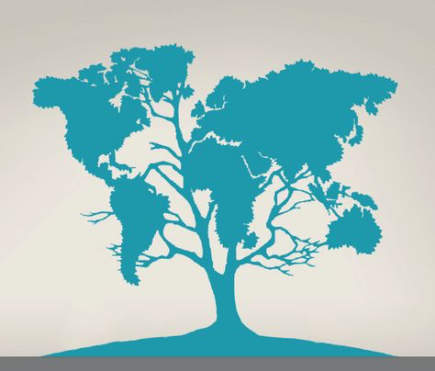
Many actions against deforestation

Slide 14
Sources
https://www.conserve-energy-future.com/various-deforestation-facts.php
https://www.livescience.com/27692-deforestation.html
https://www.onegreenplanet.org/animalsandnature/5-big-causes-of-deforestation-and-how-you-can-stop-it/
https://www.conserve-energy-future.com/causes-effects-solutions-of-desertification.php
https://greentumble.com/causes-and-effects-of-desertification/
https://www.un.org/press/en/2012/gaef3352.doc.htm

Slide 15
Thank you for your attention
Do you have any questions?

